Slide 1
Practical Part
Software Support for Applied Maths and Graph Theory
DOT

Slide 2
Prerequisites
I assume you have VS Code >= 1.65.2
The following extensions are installed
Graphviz (dot) language support (João Pinto)
Alternatively, you can use an online tool: https://dreampuf.github.io/GraphvizOnline/

Slide 3
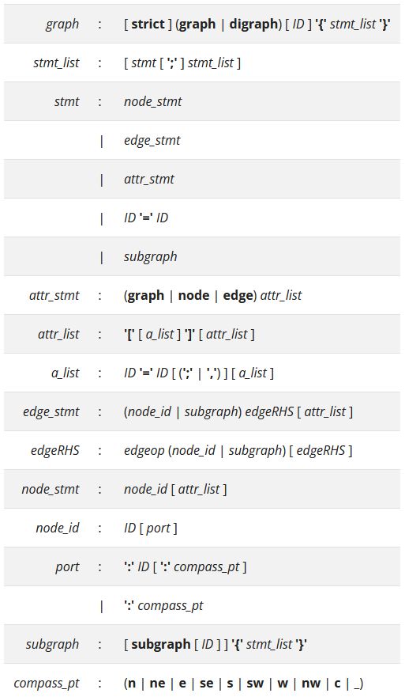
DOT Syntax

Slide 4
DOT Syntax
A graph can either be undirected ("graph") or directed ("digraph")
graph MyGraph { … }
A graph can be described purely by specifying its edges, the nodes are inferred automatically
graph MyGraph { 1 -- 2 }
Edges must comply with the type of graph
"--" for undirected graphs
"->" for directed graphs

Slide 5
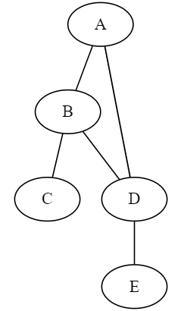
Simple Example
graph Sample1 {
A -- B -- C;
B -- D -- E;
A -- D;
}

Slide 6
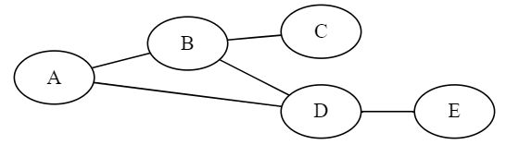
Simple Example
graph Sample1 {
rankdir = LR
A -- B -- C;
B -- D -- E;
A -- D;
}

Slide 7
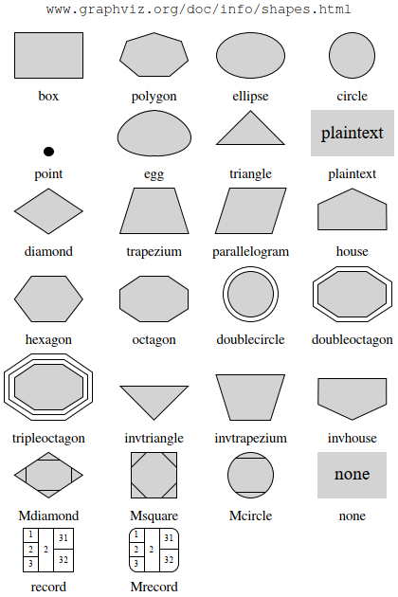
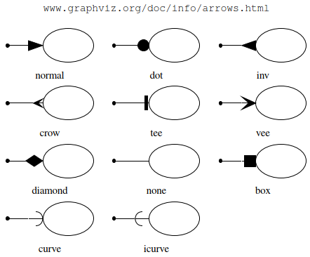
DOT Syntax
Attributes can alter the appearance of nodes and edges
Node shapes, arrowhead (for digraph)

Slide 8
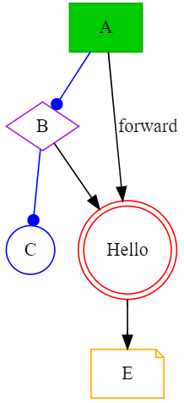
DOT Syntax
Attributes can alter the appearance of nodes and edges
Colors, fill styles, etc.
More complex labels
digraph {
A [shape = rectangle, color = "#00AA00", style = filled, fillcolor = "#00CC00"];
B [shape = diamond, color = purple];
C [shape = circle, color = blue];
D [shape = doublecircle, color = red, label = "Hello"];
E [shape = note, color = orange];
A -> B -> C [color = blue, arrowhead = dot];
B -> D -> E [];
A -> D [label = "forward"];
}

Slide 9
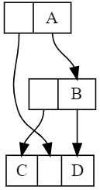
Records
Records are special types of nodes
Allow to specify specific ports and connect between those ports
digraph Sample3 {
node [shape = record, height = 0.1];
node0 [label = "<f0> |<f1> A"];
node1 [label = "<f0> |<f1> B"];
node2 [label ="<f0> C|<f1> |<f2> D"];
node0:f0 -> node2:f1;
node0:f1 -> node1:f1;
node1:f0 -> node2:f0;
node1:f1 -> node2:f2;
}

Slide 10
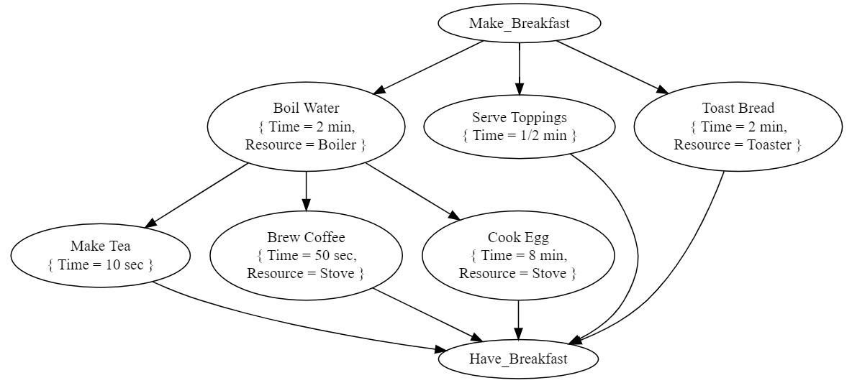
Precedence Graph

Slide 11
Group Assignment
Choose one among the following projects (or think of your own)
You want to build your dream house
You want to go for a world-round-trip
You want to propose to your loved one
You expect your first baby
You want to enroll at a university
Describe your actions as a precedence graph
Use descriptive names
Think of relevant attributes

